Slide 1
Machine Learning for investigating Predictive Power of Biomedical Data in inferring Cardiac Category

Slide 2
Introduction
This paper analyses the Biomedical Data of 86 individuals consisting of 288 features, each belonging to 1 out of 8 feature sets from clinical measurements to metabolomics data. The goal is as follows:
Analysis of feature set and its predictive power: To explore the predictive power of each feature set (except echo) in determining cardiac category
Feature Ranking: To rank and highlight the most important features for predicting cardiac category to evaluate their potential as biomarkers and/or propose its biological relationship to cardiac health/ EA Ratio.
Diagnostic Classifier: To create an optimised diagnostic classifier using an engineered set of features that does not require expensive gold-standards clinical indicators like echo and cmr.
Data Pre-processing
Columns with more than 15% of missing data are removed
Median imputation is performed on the remaining columns with missing data. Median is preferred over mean due to the presence of outliers.
Exploratory Data Analysis: Mean, Standard Deviation and Interquartile Range
 | Age (Healthy) | Age (Unhealthy) | Weightkg (Healthy) | Weightkg (Unhealthy) | Heightcm (Healthy) | Heightcm (Unhealthy) | Pulse (Healthy) | Pulse (Unhealthy) | WaistCircumferencecm (Healthy) | WaistCircumferencecm (Unhealthy) | Gender_Male_0_Female_1 (Healthy) | Gender_Male_0_Female_1 (Unhealthy) | SBP (Healthy) | SBP (Unhealthy) | DBP (Healthy) | DBP (Unhealthy) | Hips_Circumference__cm (Healthy) | Hips_Circumference__cm (Unhealthy)
count | 42 | 44 | 42 | 44 | 42 | 44 | 42 | 44 | 42 | 44 | 42 | 44 | 42 | 44 | 42 | 44 | 42 | 44
mean | 72.01546 | 71.49907 | 57.18333 | 61.92955 | 158.3095 | 159.3182 | 70.38095 | 77.11364 | 78.21429 | 82.5 | 0.5 | 0.5 | 146.2619 | 153.3409 | 74.28571 | 72.72727 | 90.54762 | 95.20455
std | 4.345915 | 4.103426 | 10.13814 | 10.88405 | 7.431765 | 7.944642 | 12.22343 | 13.00843 | 9.756888 | 10.07991 | 0.506061 | 0.505781 | 16.35738 | 49.42457 | 9.890339 | 11.45134 | 5.823428 | 6.849137
min | 61.05479 | 60.97808 | 38.2 | 45.8 | 144 | 142 | 43 | 55 | 58 | 61 | 0 | 0 | 109 | 118 | 54 | 43 | 80 | 82
25% | 68.74384 | 67.83219 | 49.725 | 55.525 | 152.25 | 154 | 61 | 67 | 70.5 | 76.75 | 0 | 0 | 139.25 | 136 | 67 | 67.75 | 85 | 90
50% | 73.35205 | 72.83562 | 56.55 | 60.6 | 157 | 158 | 71 | 76 | 78 | 83 | 0.5 | 0.5 | 146 | 145 | 73 | 74.5 | 91 | 95
75% | 75.06781 | 74.13836 | 64.025 | 67.725 | 164.75 | 165.625 | 78 | 84.25 | 83 | 89 | 1 | 1 | 153.75 | 156 | 82.5 | 81 | 95.75 | 99
max | 78.29041 | 79.41918 | 79 | 92.7 | 172 | 178.5 | 102 | 109 | 101 | 110 | 1 | 1 | 195 | 457 | 92 | 96 | 103 | 110
Basis statistics for each feature, split into cardiac categories.
For reference and future investigations/analysis.

Slide 3
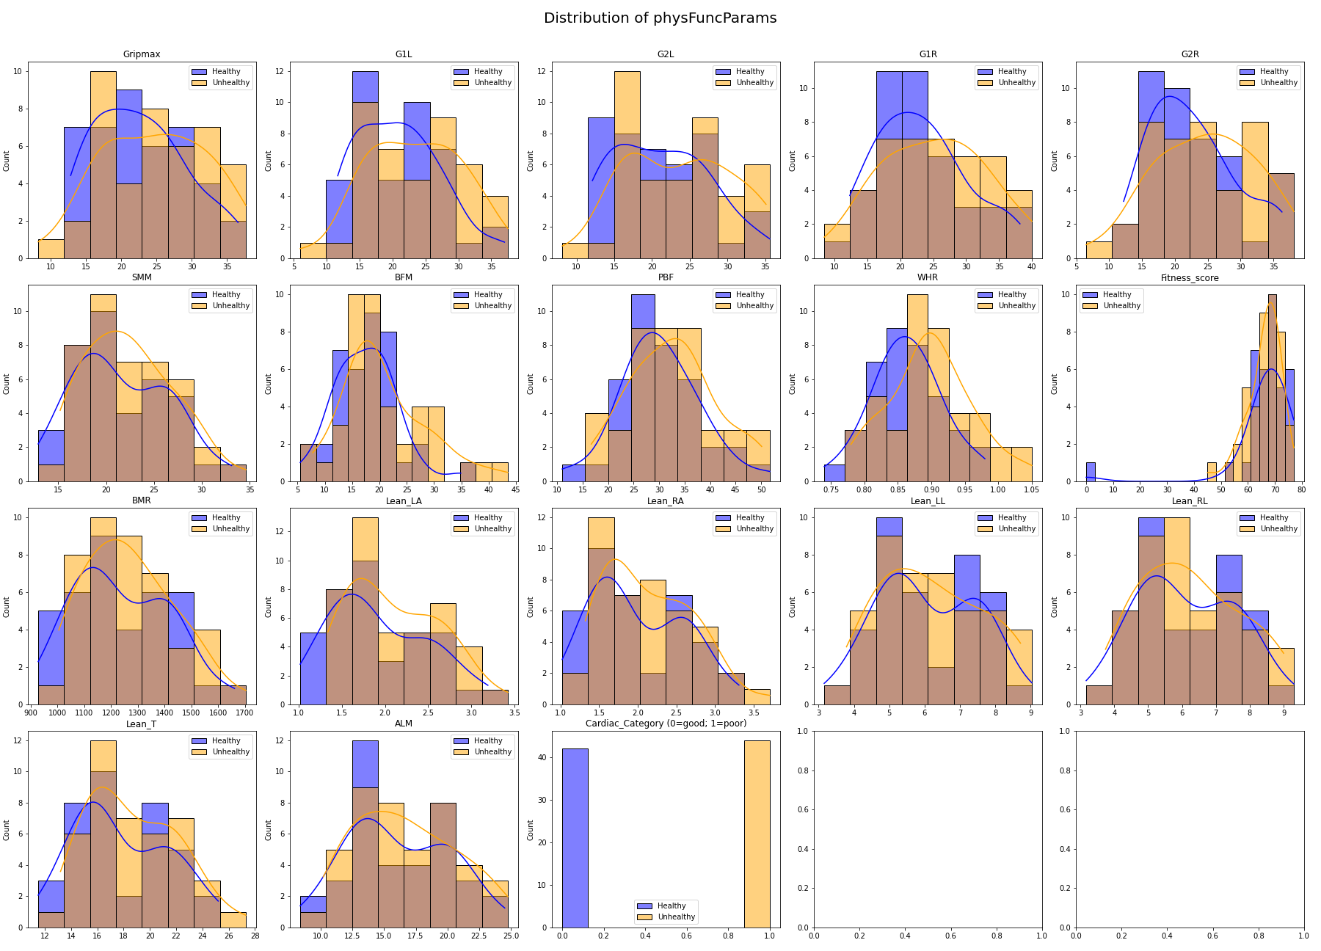
Exploratory Data Analysis: Distribution
We plot the distribution of each feature using histogram and kernel density estimate, splitting the plot based on cardiac categories
Useful for finding patterns by inspection
Categories that show a distinct split in distribution between the 2 cardiac categories can be interpreted as having potential for diagnostic use

Slide 4
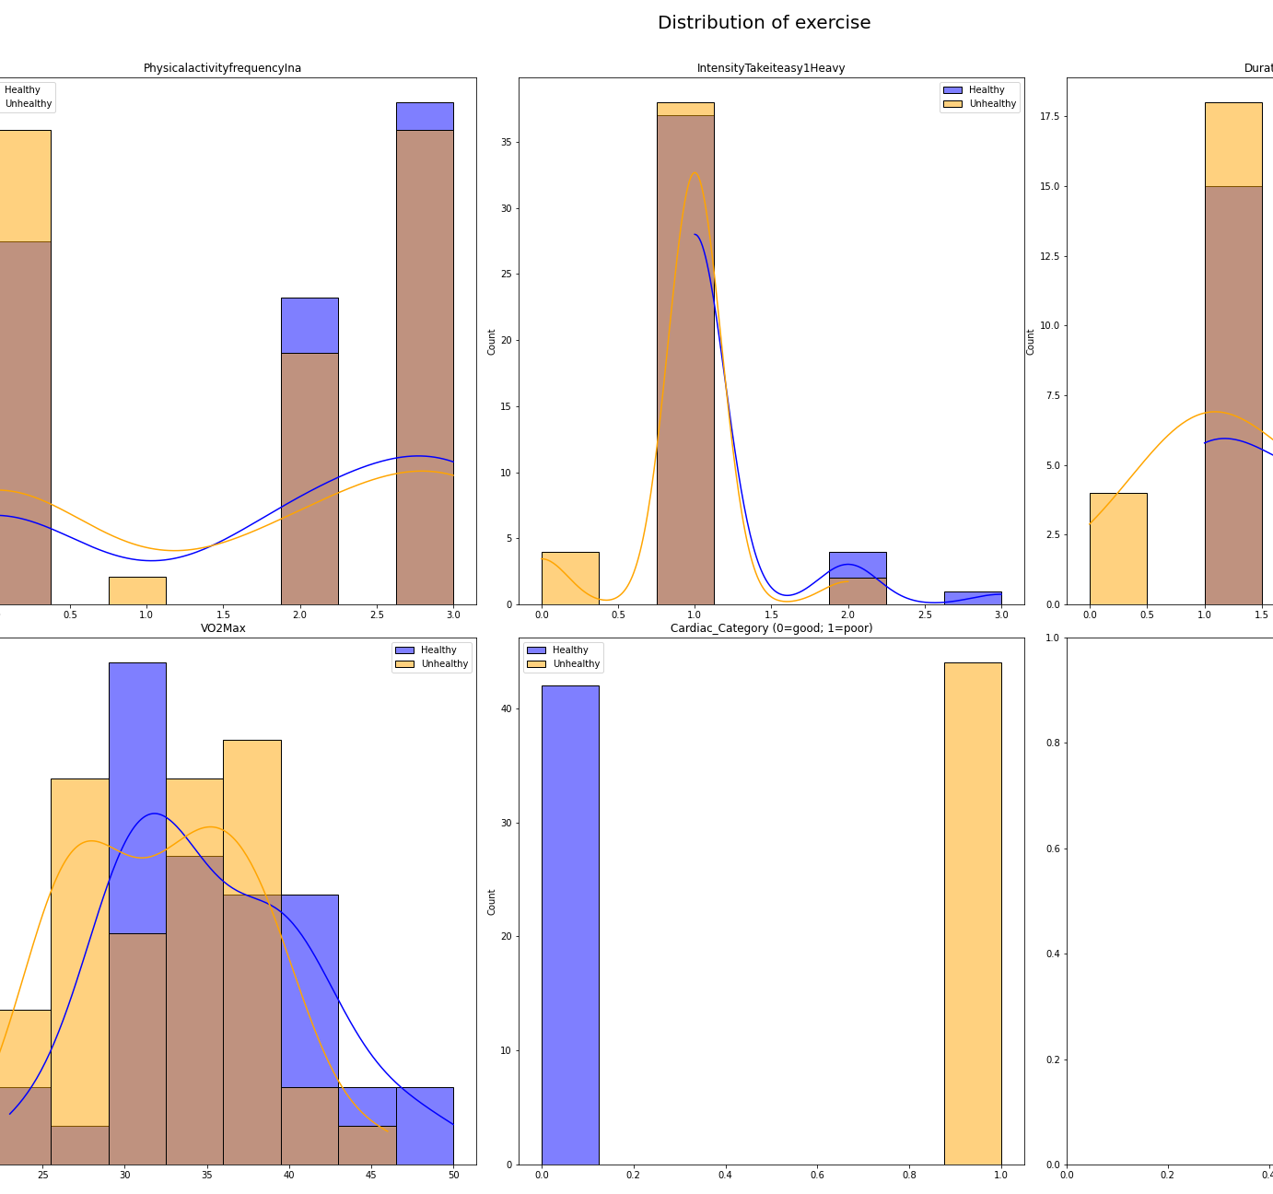
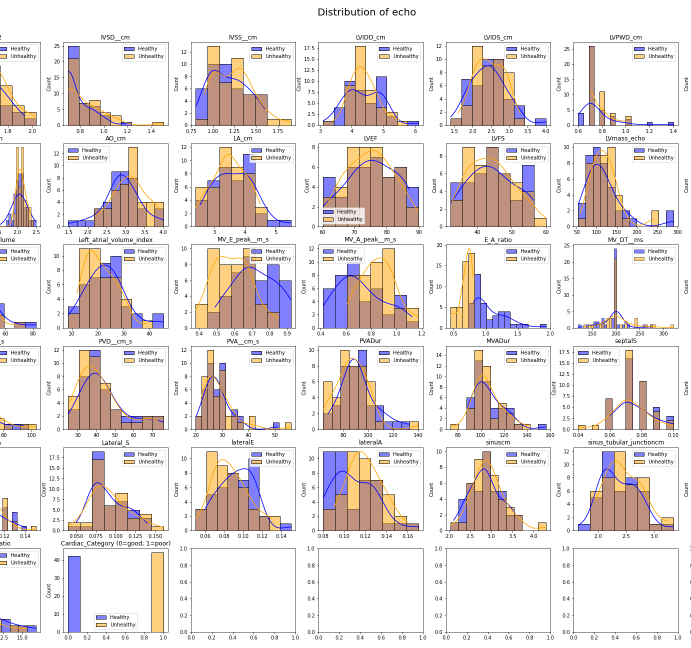
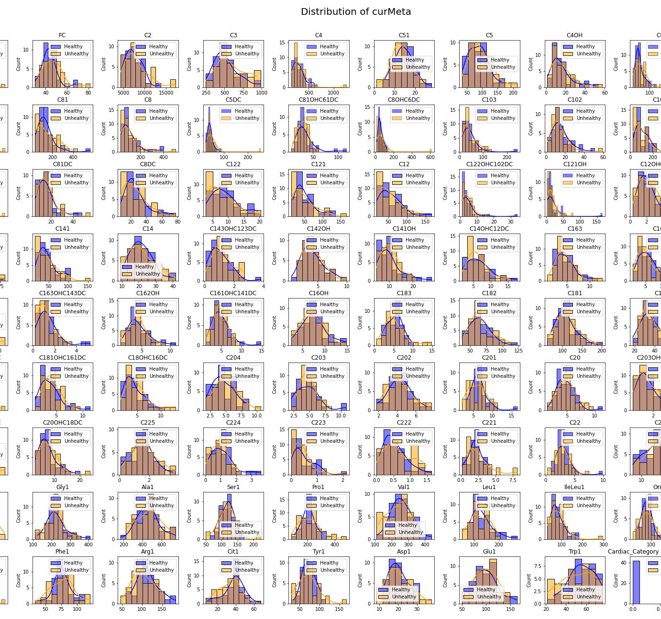
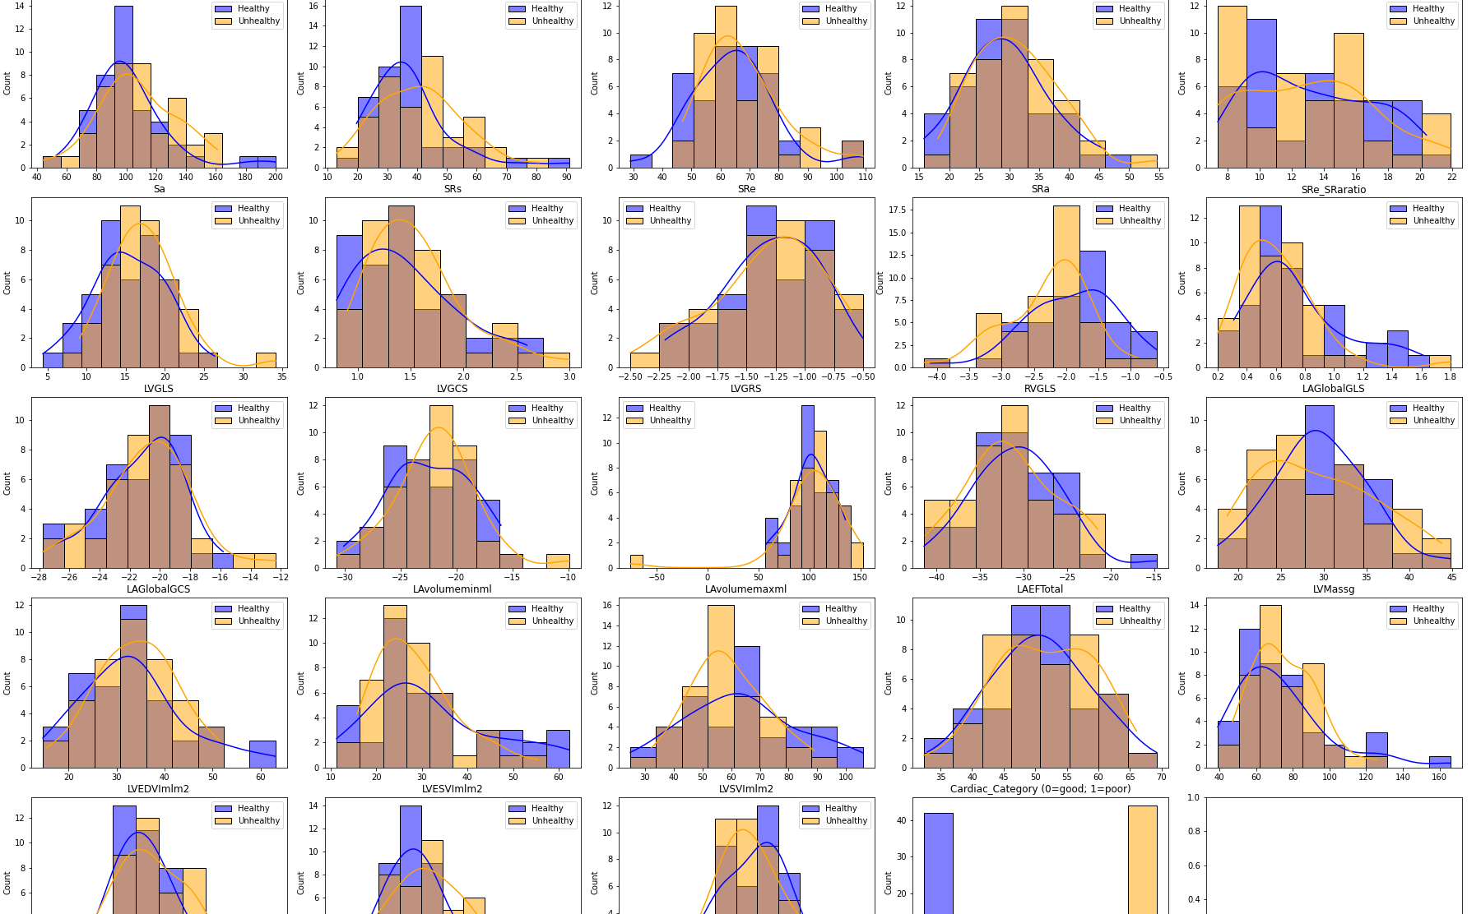
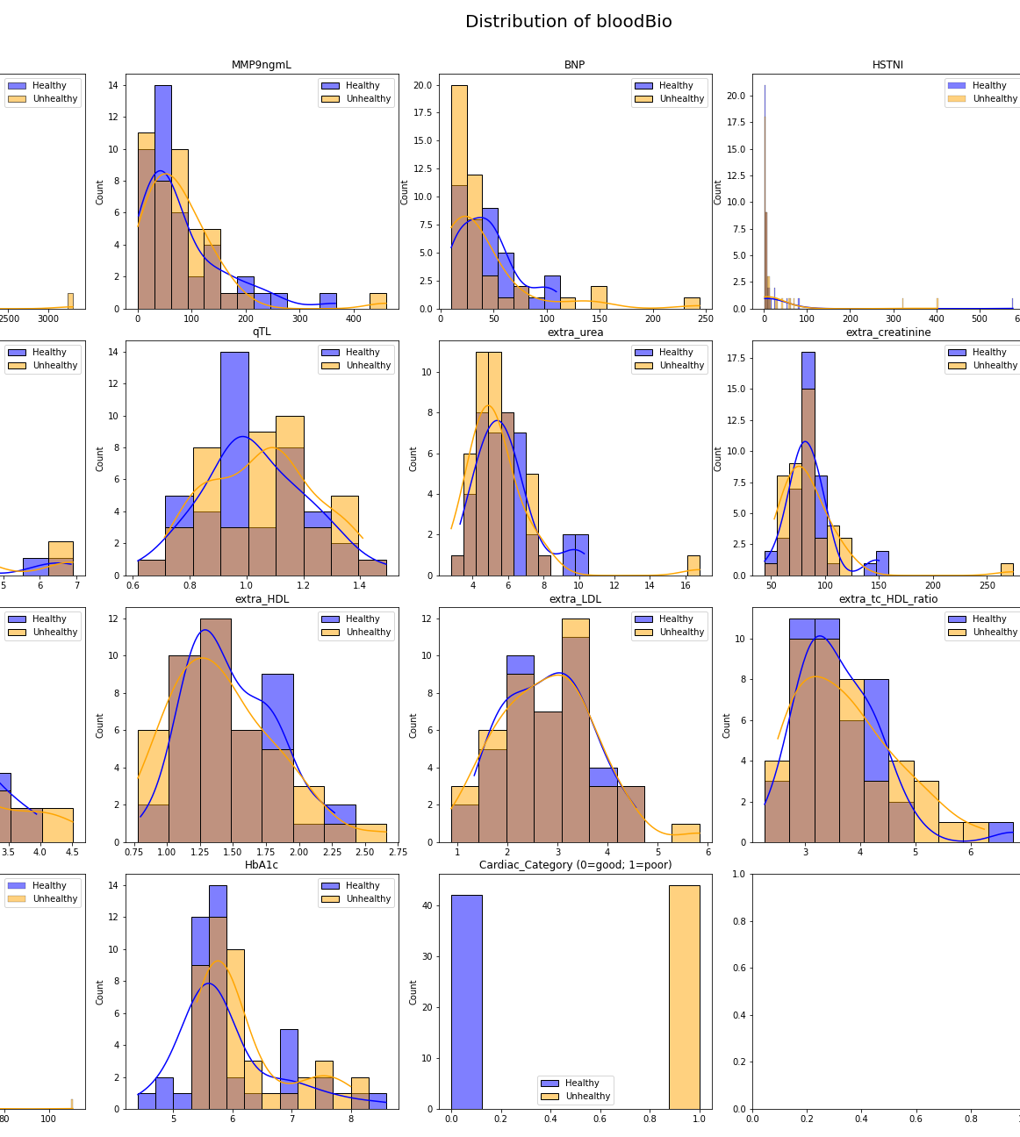
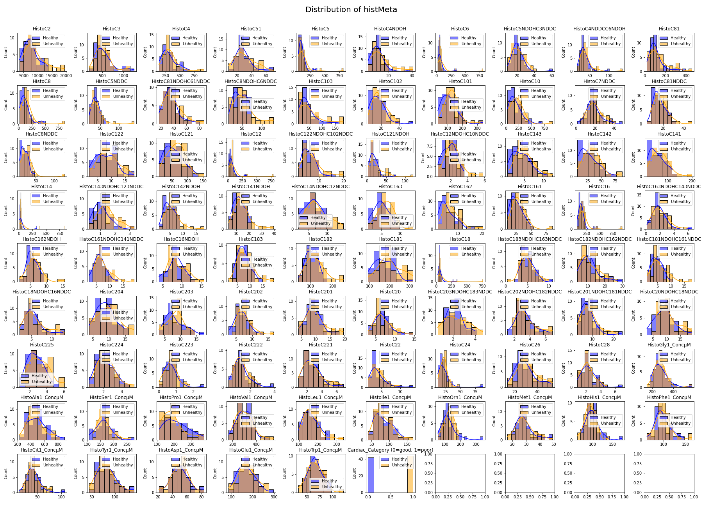
Exploratory Data Analysis: Distribution

Slide 5
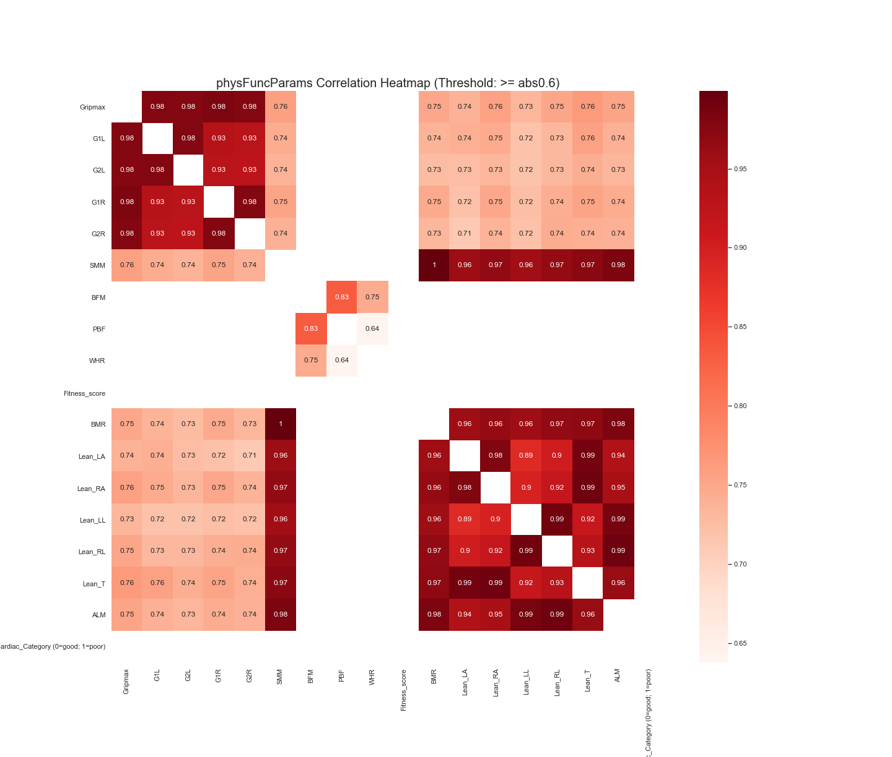
Exploratory Data Analysis: Correlation Heatmap
We plot a correlation matrix using the Pearson correlation coefficient for each parameter set to explore the relationship between variables within each set, highlighting strong absolute linear correlations above 0.6.
Allows us to study the linear relationship between different features and aids further investigation.

Slide 6
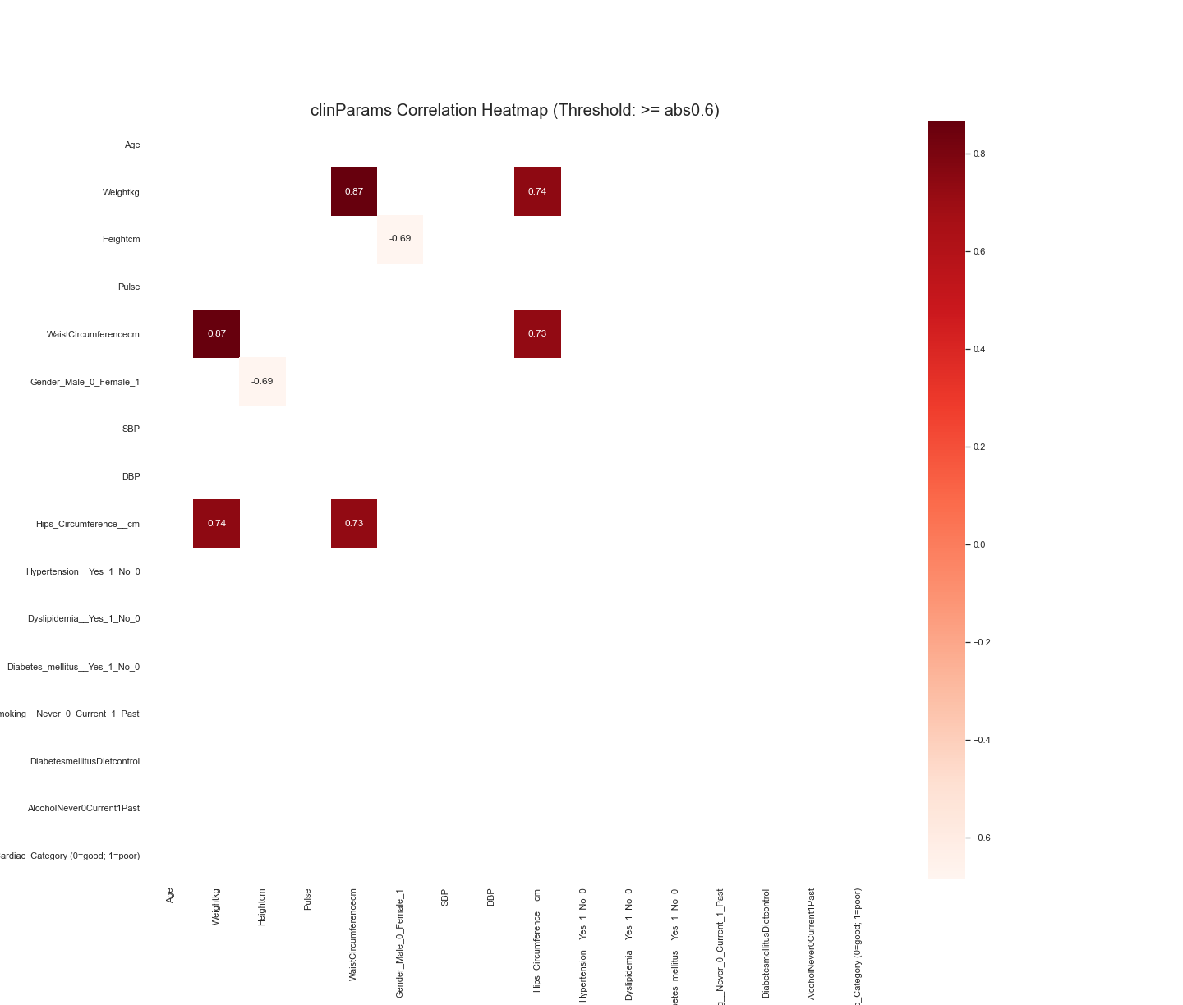
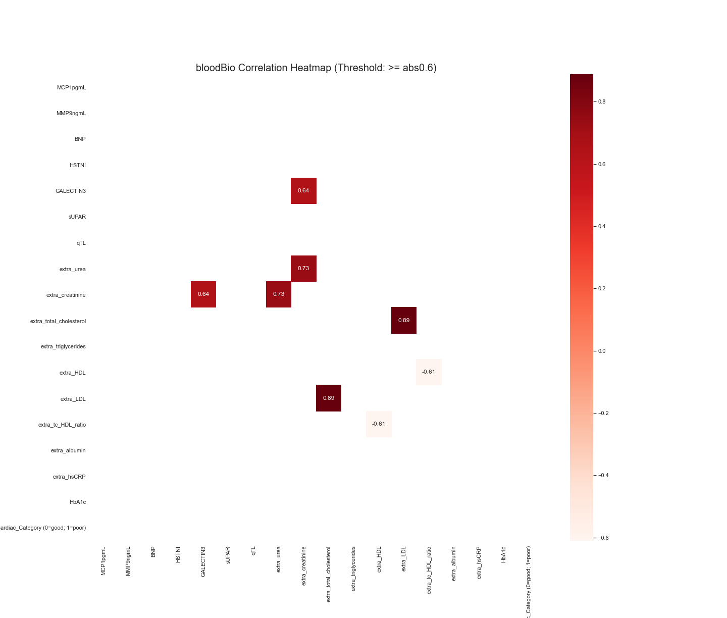
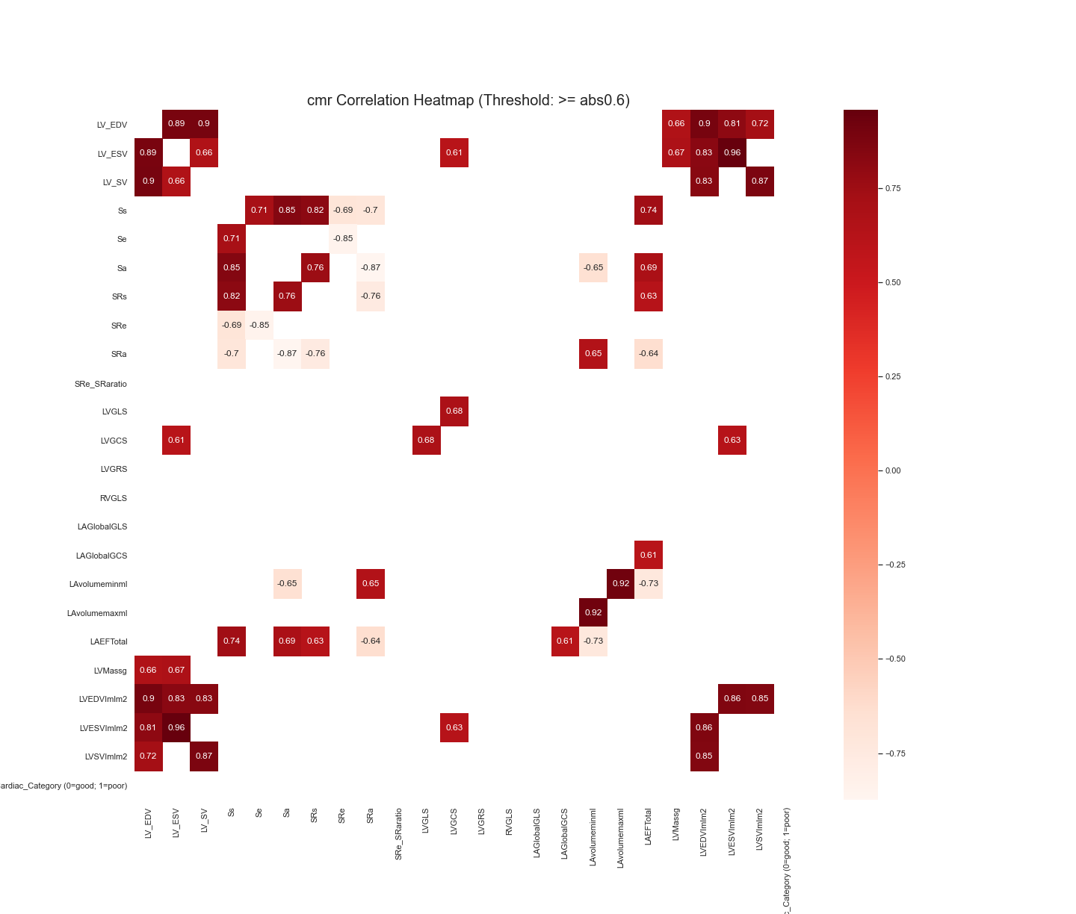
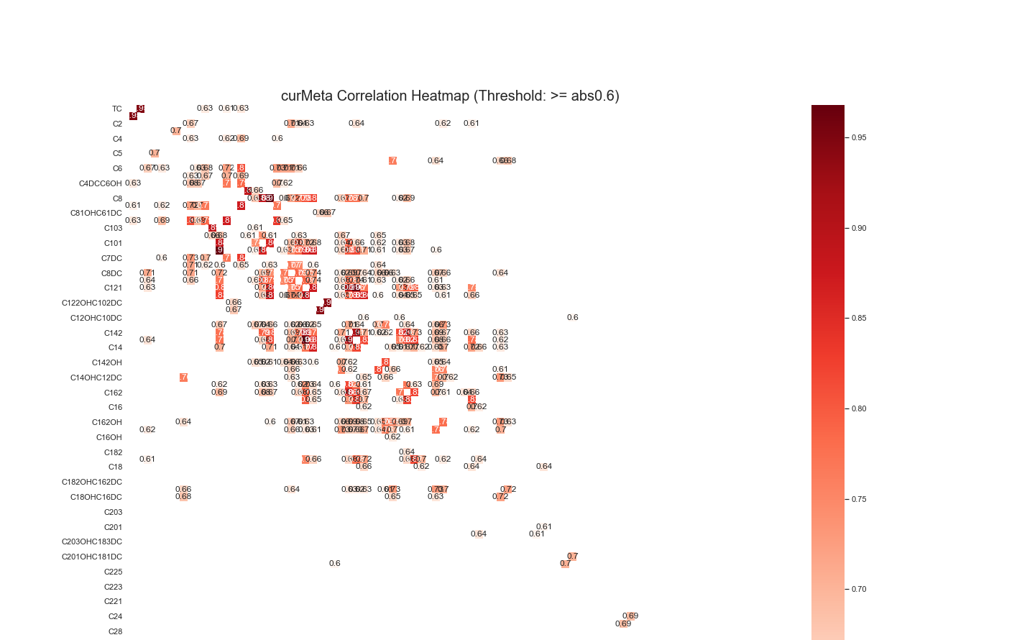
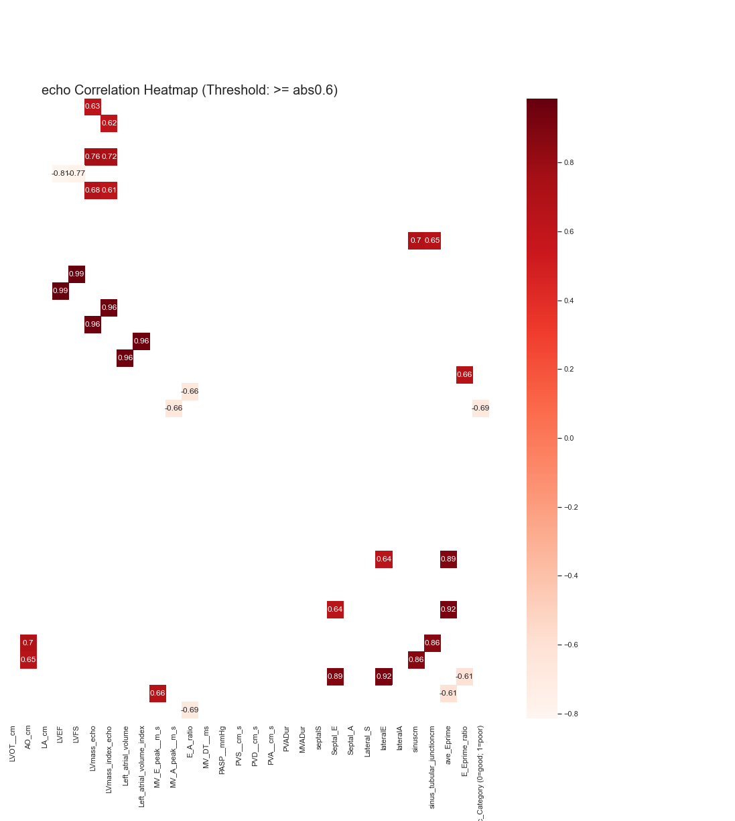
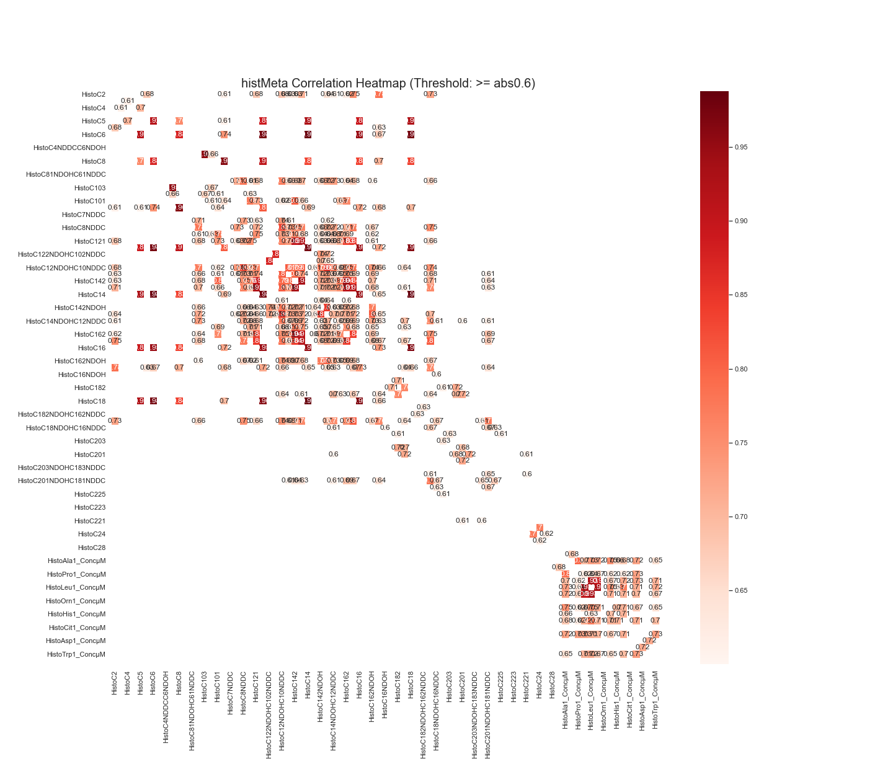
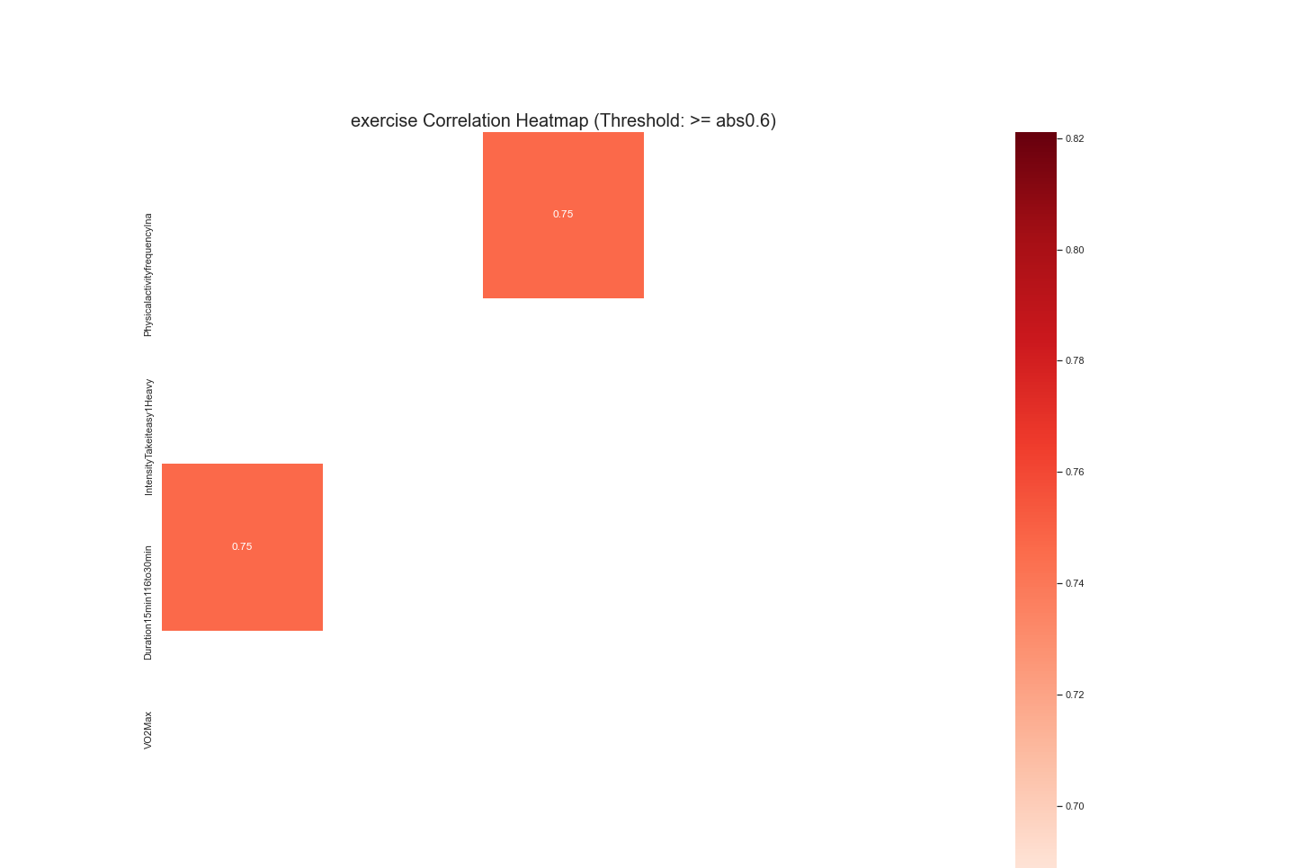
Exploratory Data Analysis: Correlation Heatmap

Slide 7
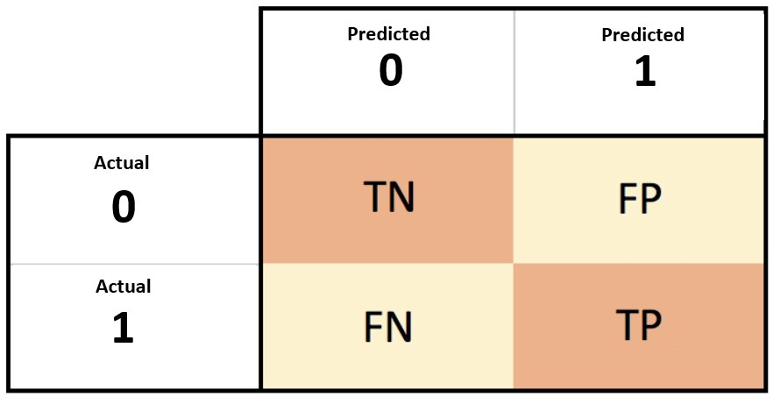
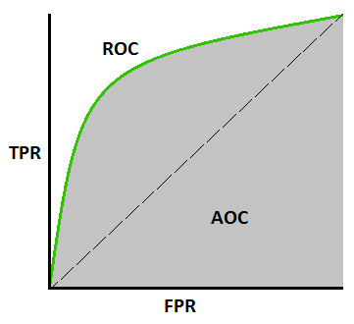

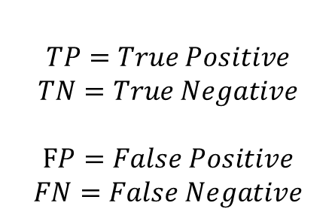



Machine Learning Considerations: Metric for model evaluation
$$TP=True Positive$$
$$TN=True Negative$$
$$FP=False Positive$$
$$FN=False Negative$$
Metrics Considered
Accuracy Score
Ratio of correct prediction to total input samples.
Useful for symmetric datasets, when roughly equal samples belong to each class, and each class is equally important to identify
Recall (Sensitivity)
Useful when it is more important to identify true positive and false positives are unimportant
Precision (Specificity)
Useful when it is more important to avoid false positives
F1 Score
Harmonic Mean of Precision and Recall
Useful in scoring classification of rare positive events
Ignores correct negatives, focusing on scoring correctly and incorrectly predicted positives
ROC AUC Score
Area under Receiver Operating Characteristics Curve, which plots the True Positive Rate against False Positive Rate
Represent probability that a randomly chosen positive example is ranked above a randomly chosen negative example
$$\frac{TP+TN }{TP+TN+FP+FN}$$
$$\frac{TP}{TP+FN}$$
$$\frac{TP}{TP+FP}$$
$$\frac{2TP}{2TP+FP+FN}$$

Slide 8
Machine Learning Considerations
Classifier Models Compared:
Logistic Regression
Gaussian Naive Bayes
K-Nearest Neighbours
Decision Tree
Random Forest
Gradient Boosting
XGBoost (eval_metric="auc“)
Light Gradient Boosting Machine
Support Vector Machine
Default setting from SciKitLearn is used for all models except XGBoost
Cross Validation
All models and algorithms are evaluated using Repeated Stratified K-Fold Cross Validation with 5 splits and 10 repeats.
Reproducibility
All Cross Validation splits and Tree-based models uses random_state = 1 for reproducibility
Model Evaluation
We use Mean Cross-Validation Accuracy Score as the primary metric for evaluating and selecting models
This is because
It is the most explainable and straightforward to interpret
We have a fairly even split of target classes (42 Healthy Cardiac Category : 44 Unhealthy Cardiac Category)
Both classes are assumed to be equally important to identify

Slide 9
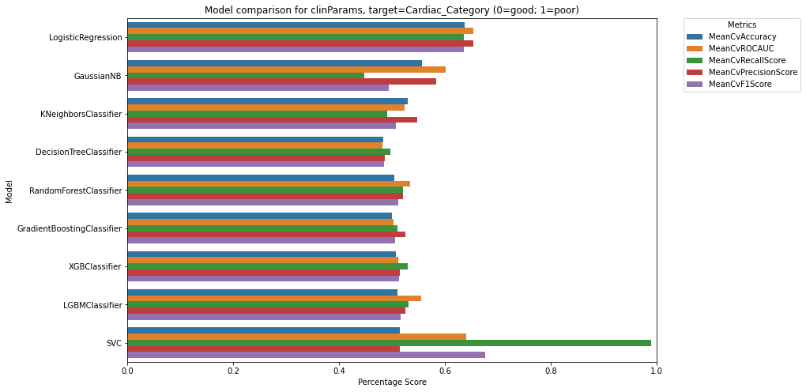
Machine Learning: Comparing predictive power of each feature set
Goal: To identify the sets of features (excluding echo, which cardiac_category is based on) with the most predictive power in the context of machine learning
Evaluation Method
The best Mean Cross-Validation Accuracy Score among all classifier models used on each feature set is used as the metric for determining the predictive power of each feature set
Results:
Clinical Parameters
Best Model: LogisticRegression
Mean Accuracy Score: 0.637
Exercise
Best Model: KNeighborsClassifier
Mean Accuracy Score: 0.654
CMR
Best Model: LGBMClassifier
Mean Accuracy Score: 0.636
Blood Biomarkers
Best Model: KNeighborsClassifier
Mean Accuracy Score: 0.536
Physical Functional Parameters
Best Model: GaussianNB
Mean Accuracy Score: 0.557
Current Metabolomics
Best Model: LogisticRegression
Mean Accuracy Score: 0.497
Historical Metabolomics
Best Model: KNeighborsClassifier
Mean Accuracy Score: 0.548
Conclusion: The feature set that appears to have the most predictive power for cardiac category in the context of machine learning is Exercise, Clinical Parameters and CMR
Due to small sample size, these score may be an overly optimistic representation of real-world performance. More data would is necessary to further support the above conclusion.

Slide 10
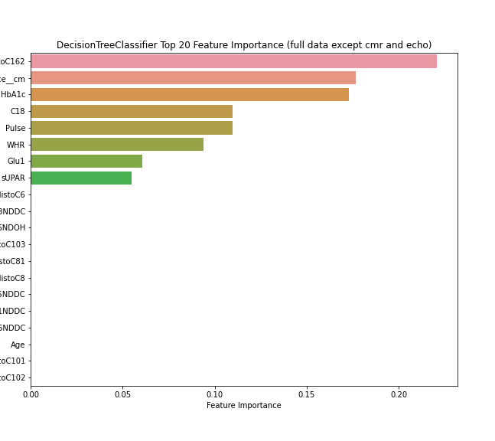
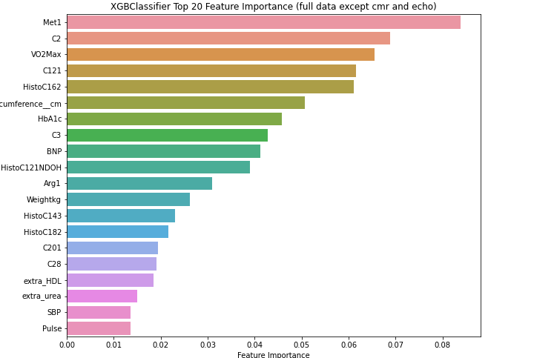
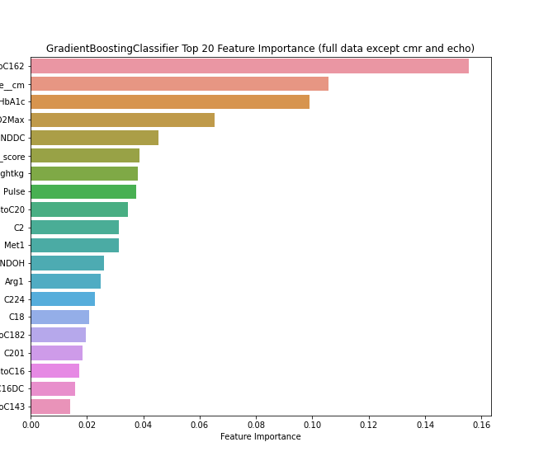
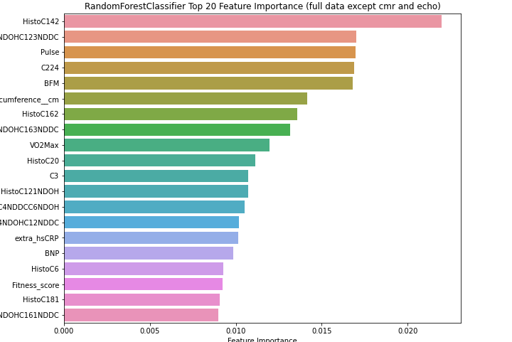
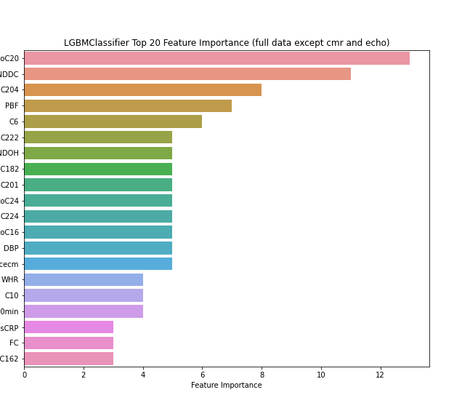
Ranking and Visualizing Feature Importance
Goal
To rank features and determine which of them have potential predictive power by visualising the top 20 important features in the 5 tree-based models, using the full and combined dataset except for echo and cmr.
Method
The 5 tree-based models contain a ‘feature_importance’ attribute, which is accessed and visualised.
These models are:
DecisionTreeClassifier
RandomForestClassifier
XGBClassifier
GradientBoostingClassifier
LGBMClassifier

Slide 11
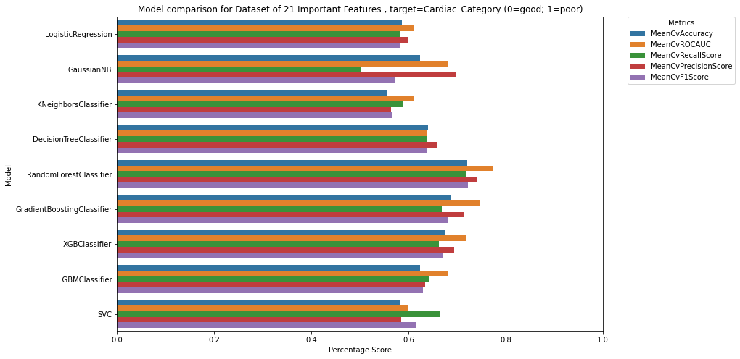
Feature Engineering: Combining important feature to build an optimized dataset
Goal
Improving model scores through reduction of data noise by only considering the most important features
Method
The top 10 features in each of the 5 models are combined. Duplicated features in the combination are removed. This leaves the following 21 features: ['C224', 'HistoC162', 'Hips_Circumference__cm', 'HistoC10', 'HistoC203NDOHC183NDDC', 'HistoC16', 'C222', 'C28', 'Tyr1', 'HistoC163NDOHC143NDDC', 'VO2Max', 'HistoC143NDOHC123NDDC', 'HistoC143', 'Pulse', 'C5DC', 'HistoC121NDOH', 'WHR', 'C102', 'C81', 'C101', 'HistoC102’]
This feature set is then evaluated on the ensemble of model previously used for comparing predictive power of each feature set
Result
Scores improved across the board, with the best performing model being RandomForestClassifier, with a Mean Cross-Validation Accuracy Score of 0.721

Slide 12
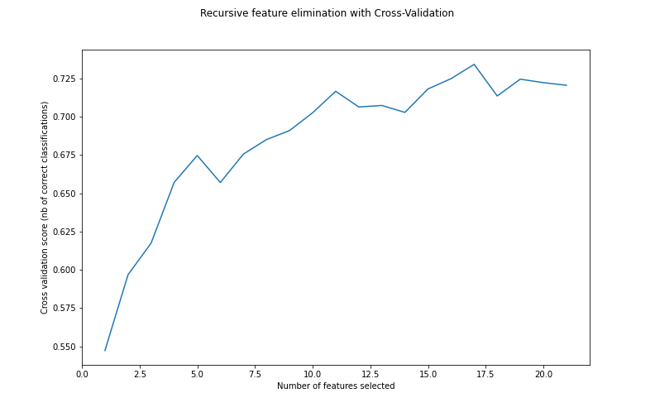
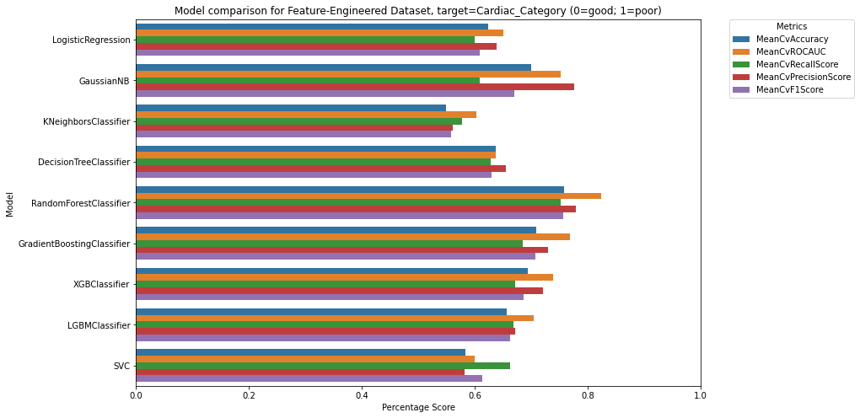
Feature Engineering: Recursive Feature Elimination for further optimization of dataset
Goal
Further optimization of model score and streamlining of the dataset.
Method
We run SciKitLearn’s RFECV (Recursive Feature Elimination with Cross Validation) using the best performing algorithm from the previous dataset (RandomForestClassifier).
This function recursively eliminates a small number of features each loop, returning the set of features that maximises the score of the given algorithm
Result
The optimal dataset is further reduced from 21 to the following 17 features:
['C224', 'HistoC162', 'Hips_Circumference__cm', 'HistoC10','HistoC203NDOHC183NDDC', 'HistoC16', 'C222', 'C28', 'Tyr1', 'VO2Max','HistoC143NDOHC123NDDC', 'HistoC143', 'Pulse', 'HistoC121NDOH', 'WHR','C81', 'C101']
Training RandomForestClassifier using the above dataset resulted in an improved Mean Cross-Validation Accuracy Score of 0.758
Model | MeanCvAccuracy | MeanCvROCAUC | MeanCvRecallScore | MeanCvPrecisionScore | MeanCvF1Score
LogisticRegression | 0.623 | 0.651 | 0.599 | 0.639 | 0.609
GaussianNB | 0.700 | 0.751 | 0.608 | 0.776 | 0.669
KNeighborsClassifier | 0.549 | 0.602 | 0.578 | 0.561 | 0.559
DecisionTreeClassifier | 0.637 | 0.637 | 0.628 | 0.655 | 0.630
RandomForestClassifier | 0.758 | 0.824 | 0.751 | 0.779 | 0.757
GradientBoostingClassifier | 0.708 | 0.768 | 0.685 | 0.730 | 0.708
XGBClassifier | 0.694 | 0.738 | 0.671 | 0.721 | 0.687
LGBMClassifier | 0.656 | 0.704 | 0.669 | 0.671 | 0.662
SVC | 0.583 | 0.599 | 0.663 | 0.582 | 0.614

Slide 13
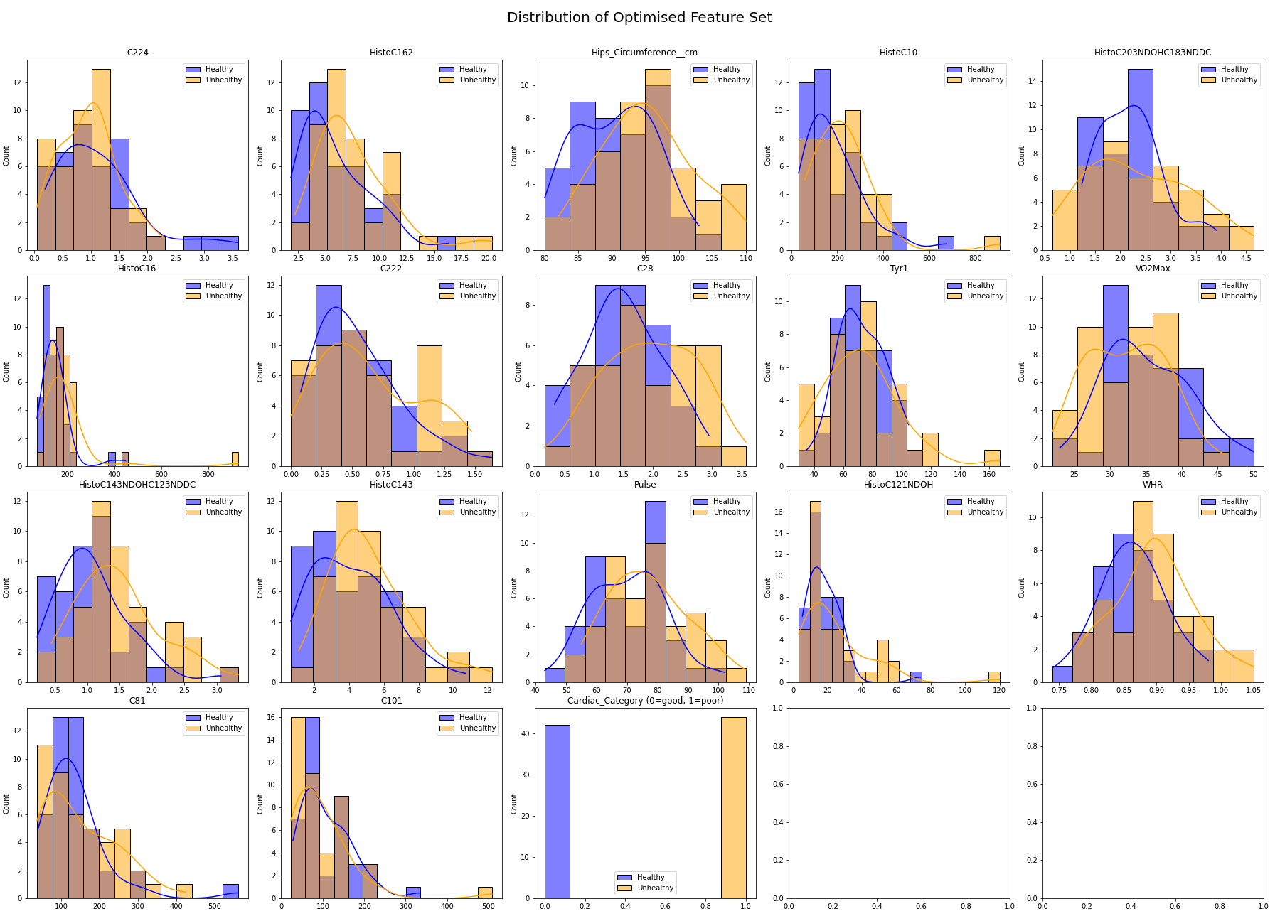
Distribution of Feature-Engineered Dataset
Number of features: 17
Historical Metabolomics: 7
HistoC10
HistoC162
HistoC203NDOHC183NDDC
HistoC16
HistoC143NDOHC123NDDC
HistoC143
HistoC121NDOH
Current Metabolomics: 6
C224
C222
C28
C101
C81
Tyr1
Clinical Parameters: 2
Hips_Circumference__cm
Pulse
Exercise: 1
VO2Max
Physical Functional Parameters: 1
WHR

Slide 14
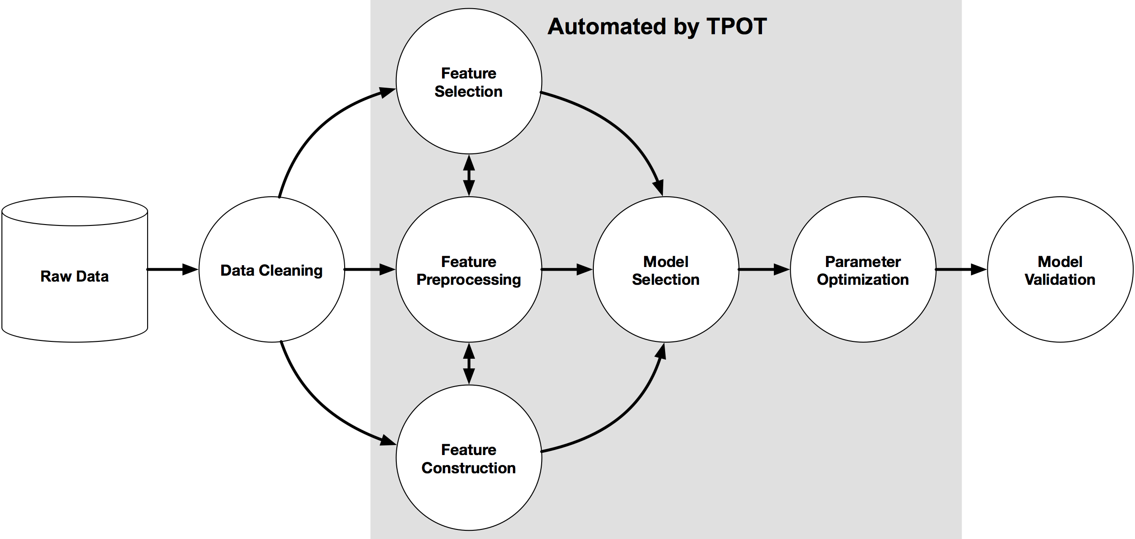
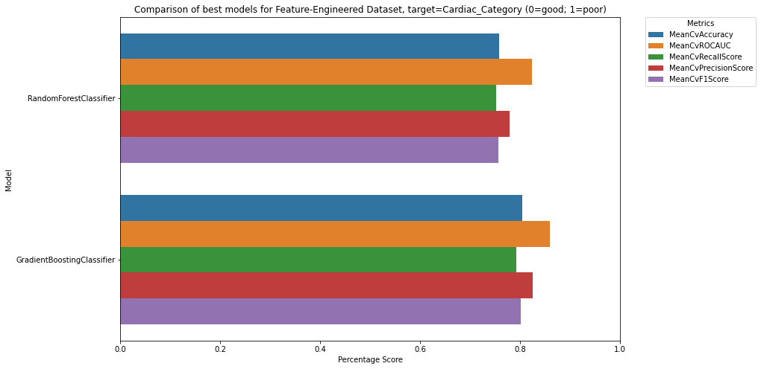
Model Selection and Hyperparameter Tuning using TPOT
Goal
Having engineered an optimal dataset, we wish to find the best model and hyperparameters that can achieve the best accuracy in classifying cardiac category.
Method
We use Tree-based Pipeline Optimization Tool (TPOT), an Automated Machine Learning tool that optimizes machine learning pipelines using genetic programming. https://dl.acm.org/doi/pdf/10.1145/2908812.2908918
We fit the engineered dataset into a TPOT Classifier and ran it for 200 generations with a population size of 50 and using the same cross-validation strategy to optimise for accuracy score.
Result
Model | MeanCvAccuracy | MeanCvROCAUC | MeanCvRecallScore | MeanCvPrecisionScore | MeanCvF1Score
RandomForestClassifier | 0.758 | 0.824 | 0.751 | 0.779 | 0.757
GradientBoostingClassifier (TPOT-Optimised) | 0.804 | 0.859 | 0.792 | 0.826 | 0.802
After 200 generations, TPOT returned the following model:
GradientBoostingClassifier(learning_rate=0.1, max_depth=4, max_features=0.1, min_samples_leaf=4, min_samples_split=11, n_estimators=100, subsample=0.7000000000000001)
This model appears to outperform RandomForestClassifier on average, with a Mean Cross-Validated Accuracy Score of 0.804.
Caveats
Though we fixed random_state to be = 1 for all Tree-based models and CV splits, averaging across 20 different random states gave MeanCVAccuracy closer to 0.749 and 0.751 for RandomForestClassifier and GradientBoostingClassifier (TPOT-Optimised) respectively.
Given the stochastic nature of TPOT, it is possible that better models can be found through repeated runs of TPOT.

Slide 15
Discussion
Overfitting
Sample size is small (86) while feature set is large (200+), there is a risk of overfitting which can lead to overly-optimistic score for models that actually performs worse in real-world scenarios. Though this risk is partially mitigated in our final feature set, which saw 200+ features reduced to 17, more data is nonetheless needed to test the model for generalisability and robustness in real-world scenarios.
Imputation
Median imputation for missing values is performed before the cross-validation process, resulting in some leakages of data from the train-set into the validation-set. This may lead to over-optimistic scores for the model.
https://stats.stackexchange.com/questions/95083/imputation-before-or-after-splitting-into-train-and-test/95088
However, I anticipate that this will have a relatively minor effect as most columns (>75%) do not require imputation and those that do have less than 15% missing values.
Biological significance
In general, for the carnitine metabolomics features in our optimised feature set, the orange KDE curve is to the right of the blue KDE curve, suggesting that an elevated carnitine levels is associated with impaired cardiac functions.
This corroborates existing research on the association of carnitine levels with impaired cardiac functions.
Plasma carnitine levels as a marker of impaired left ventricular functions: https://pubmed.ncbi.nlm.nih.gov/11129956/

